Slide 1

DIRECTION SENSE

Slide 2
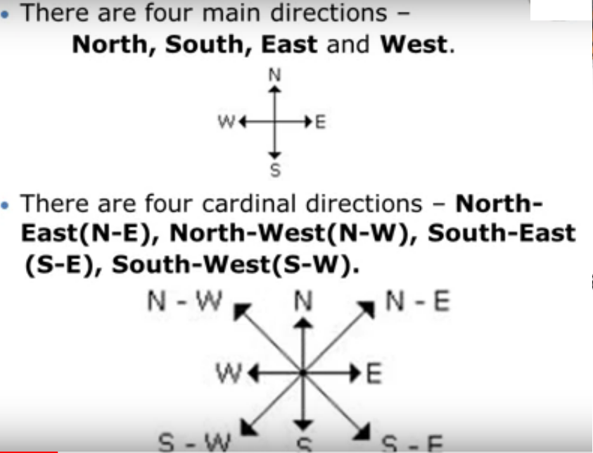

Slide 3
SHADOWS

Slide 4
FACTS :
Shadow always lie opposite to the source of light.
In the morning, Sun rises in the east so all shadows will appear in the west.
In the evening, Sun sets in the west so all shadows will appear in the east.
At 12 o’clock no shadows is formed.
If person’s face is visible then he is facing South.
If person’s back is visible then he is facing North.

Slide 5
One morning after sunrise, the shadow of a girl fell exactly to her right. To which direction is she facing? A) East B) South C) West D) Data Inadequate

Slide 6
Two people A and B are facing each other. The time of the day is late evening when the sun is setting. If A’s shadow falls to his left, find the direction that B is facing? A) East B) South C) West D) North

Slide 7
Sita and Geeta were standing facing each other at 8a.m. Shadow of the Geeta fell exactly to her right. To which direction Sita facing. A) East B) South C) North D) Data Inadequate

Slide 8
23. One evening before sunset two friends Sumit and Mohit were talking to each other face to face. If Mohit’s shadow was exactly to his right side, which direction was Sumit facing? (a) North (b) South (c) West (d) Data inadequate

Slide 9
24. One morning after sunrise, Reeta and Kavita were talking to each other face to face at Tilak Square. If Kavita’s shadow was exactly to the right to Reeta, which direction Kavita was facing? (a) North (b) South (c) East (d) Data inadequate

Slide 10
Y is in the east of X which is in the north Z. If P is in the south of Z, then in which direction of Y, is P?
South
West
South-West
None of these

Slide 11
TYPES OF QUESTIONS:
Finding final Direction
Finding final Distance
Finding Distance and Direction
Change of Direction
Shadows

Slide 12
A boy rode his bicycle northwards, then turned left and rode one km and again turned left and rode 2 km. He found himself exactly one km west of his starting point. How far did he ride northwards initially?
1 km
2 km
3 km
5 km

Slide 13
One day, Ravi left home and cycled 10 km southwards, turned right and cycled 5 km and turned right and cycled 10 km and turned left and cycled 10 km. How many kilometres will he have to cycle to reach his home straight?
10 km
15 km
20 km
25 km

Slide 14
Rohit walked 25 metres towards South. Then he turned to his left and walked 20 metres. He then turned to his left and walked 25 metres. He again turned to his right and walked 15 metres. At what distance is he from the starting point and in which direction?
35 metres east
35 metres north
40 metres east
60 metres east

Slide 15
A child is looking for his father. He went 90 meters in the East before turning to his right. He went 20 meters before turning to his right again to look for his father at his uncle’s place 30 meters from this point. His father was not there. From here he went 100 meters to the North before meeting his father in a street. What is the smallest distance between the starting point and his father’s position?
A) 80 B)100 C)90 D)70

Slide 16
Ravi starts from his house and moves toward South. He walks 100 m, then turns left and walks 200m, turns right and walks 500m. How far is he from his house ?
400 √2 m
200 √2 m
800 m
200 √10 m

Slide 17
A man went 10 kms towards south. Then turned East and covered 10 kms and turned to the right. Again after 10 kms he turned to the left and covered 10 kms to reach the destination.
How far and in which direction is he to his starting point?
20 √2 km, south-east
20 √2 km, north-east
20 √2 km, south-west
20 km, south-east

Slide 18
Aman starts from his house and walks 2 km east up to his class and turns southwards and walks 1 km up to his friend’s house. At the friend’s house, he turns to east and walks 2 km up to his school. He then turns northwards and walks 4 km to the garden. How far is he from his house?
a. 5 km b. 7 km c. 4 km d. 2.5 km

Slide 19
16. Ramesh is facing towards South and turns 45 ° anti-clockwise. He turns again 180 ° in anti-clockwise direction. Now, he turns 270 ° clockwise. Which direction is he facing now?
A) West
B) East
C) South-West
D) North – East
E) None of these

Slide 20
Akash is facing North and walks 10ms. He turns 270 ° anti-clockwise and walks 15ms. Now he gain turns 45 ° clockwise and walks for 25 ms. In which direction is he facing now?
a) North-West
b)South-West
c)North-East
d) South-East

Slide 21
Arya and Bindya start from a point simultaneously. Arya moves to his East and travels 12 km, and Bindya moves to her south and travels 12 km. Arya takes a 270° anti-clock wise turn and travels 12 km. Bindya takes a 90° clock wise turn and runs 18km. Then Bindya goes 30km in same line in exactly opposite direction. Which of the following is true regarding their positions?
1) Bindya has travelled 30 km more than Arya 2) both are to the south east of original position 3) both are at the same point

Slide 22
I am facing south. I turn right and walk 20 m. Then I turn right again and walk 10 m. Then I turn left and walk 10 m and then turning right walk 20 m. Then I turn right again and walk 60 m. In which direction am I from the starting point
(a) North
(b) North- west
(c) East
(d) North -east

Slide 23
Sobha was facing East. She walked 20 metres. Turning left she moved 15 metres and then turning right moved 25 metres. Finally, she turned right and moved 15 metres more. How far is she from her starting point?
25 metres
35 metres
50 metres
45 metres

Slide 24
Gaurav walks 20 metres towards North. He then turns left and walks 40 metres. He again turns left and walks 20 metres. Further, he moves 20 metres after turning to the right. How far is he from his original position?
45 metres
60 metres
50 metres
40 metres

Slide 25
A man walks 5 km toward south and then turns to the right. After walking 3 km he turns to the left and walks 5 km. Now in which direction is he from the starting place?
A. West
B. South
North-East
south-West

Slide 26
Starting from the point X, Jayant walked 15 m towards west. He turned left and walked 20 m. He then turned left and walked 15 m. After this he turned to his right and walked 12 m. How far and in which directions is now Jayant from X?
32 m, South
47 m, East
42 m, North
27 m, South

Slide 27
A man walks 2 km towards North. Then he turns to East and walks 10 km. After this he turns to North and walks 3 km. Again he turns towards East and walks 2 km. How far is he from the starting point?
10 km
13 km
15 km
none of these

Slide 28
Rasik walks 20 m North. Then, he turns right and walks 30 m. Then he turns right and walks 35 m. Then he turns left and walks 15 m. Then he again turns left and walks 15 m. In which direction and how many metres away is he from his original position?
15 metres west
30 metres east
30 metres west
45 metres east

Slide 29
UNIT DIGIT

Slide 30
Find Unit Digit:
185⁵⁶³
271⁶⁹⁸⁷
56²⁵³⁶⁹
152¹⁶
7923³⁶⁴
564⁶²³⁴⁴
9287⁴²
3508²⁵³⁴⁹
999⁹⁹⁹
(22²² + 33³³ + 44⁴⁴ )

Slide 31
Unit Digit

Slide 32
The unit's digit in the product of (256 × 27 × 159 × 182) is –
a)4 b) 5 c) 6 d) 7
2. The unit's digit in the product of ((27)^4 × (31)^8 × (56)^7 × (33)^3)
a)2 b) 3 c) 4 d)5
3. What is the number in the unit's place of (743)^74 ?
a)6 b) 7 c) 8 d)9
What is the number in the unit's place of (72)^75 ?
a)6 b) 7 c) 8 d)9
5. What is the number in the unit's place of (123)^42 ?
a)6 b) 7 c) 8 d)9
1. c 2. A 3. d 4. c 5. d

Slide 34
THANK YOU

